Slide 1

Manchester Raspberry Jam 38
August 2016

Slide 2
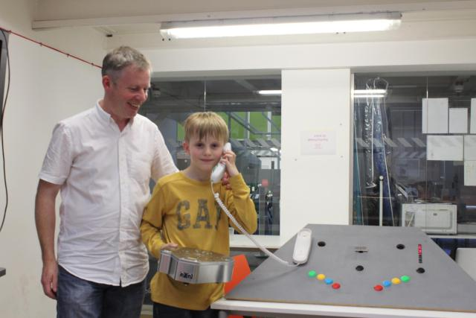
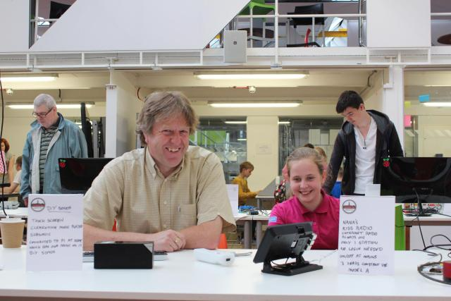
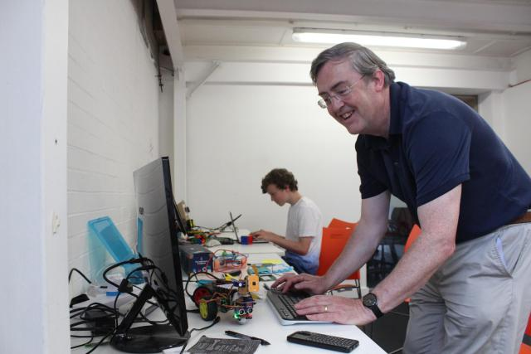
Last Time:

Slide 3
Workshops & Activities
Morning:
Workshop 10: ARM Assembly
Basics of ARM Assembly
Hello, World!
Afternoon:
Minecraft: Pi Edition
Intro to Python
Minecraft Python API

Slide 4
Raspberry Pi brand survey
John Nguyen, a student from the University of East Anglia, would like to hear your thoughts on the Raspberry Pi brand.
https://www.surveymonkey.co.uk/r/Y57SQCQ

Slide 5
Today:
11:00 - ARM Workshop
13:30 - Lunch
14:30 - Minecraft Workshop
WiFi:
SSID MMU-Visitor
Pass. University
Next Jam:
Saturday 9th October Tickets up shortly
Brand Survey: https://www.surveymonkey.co.uk/r/Y57SQCQ
Share photos with #McrRaspJam
Slides and other downloads at: bit.ly/McrRaspJam

